Slide 1


SMART INDIA HACKATHON 2024
Coastal Tourism Safety Advisor
Problem Statement ID – SIH1656
Problem Statement Title- Development of a mobile application to provide recreational suitability information of beach locations across India.
Theme - Travel & Tourism
PS Category- Software
Team ID -
Team Name: AquaTeq

Slide 2
Coastal Tourism Safety Advisor
AquaTeq
"B.R.E.E.Z.E" is an innovative mobile app that enhances users experience for coastal tourism by providing real-time assessments of beach conditions across India.
By integrating data from INCOIS, IMD and other meteorological sources, it evaluates factors like wave height, ocean currents etc., to determine beach suitability. It Delivers color-coded safety indicators and personalized alerts, helping tourists make informed decisions and avoid hazards.
Key features: Geolocation-based safety tracking, instant alerts for high-risk areas, and an SOS emergency button that transmits location to rescue teams or Local government.
With its user-friendly design, "B.R.E.E.Z.E" is a vital tool for tourists and authorities, ensuring safer beach experiences in the growing coastal tourism sector.

Slide 3
TECHNICAL APPROACH
AquaTeq
Frontend
React Native for cross-platform mobile development (iOS and Android)
Backend
Cloud services (Azure & GCP)
Real-time data processing
API integration
APIs
INCOIS, MAUSAM - Oceanographic data and weather data
Google - Maps API
Methodology
AGILE methodology: Scrum
Programming Languages/Tools
Python
Javascript
Flutter
Figma
Features
Seamless UI
Real-time geospatial mapping
Reliable alert systems (including SOS)

Slide 4
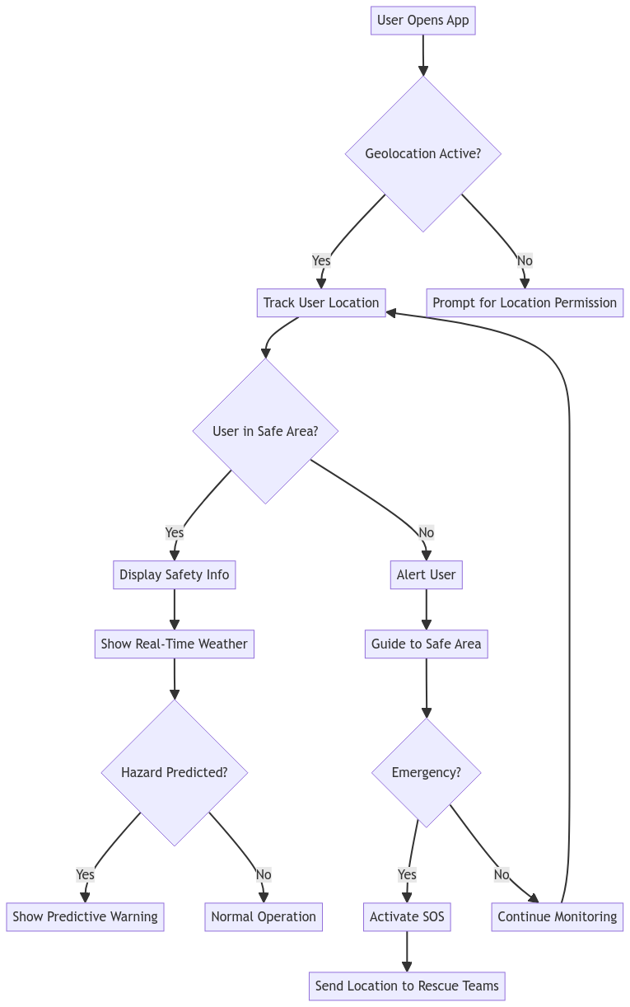
TECHNICAL APPROACH
AquaTeq
Flow Diagram

Slide 5
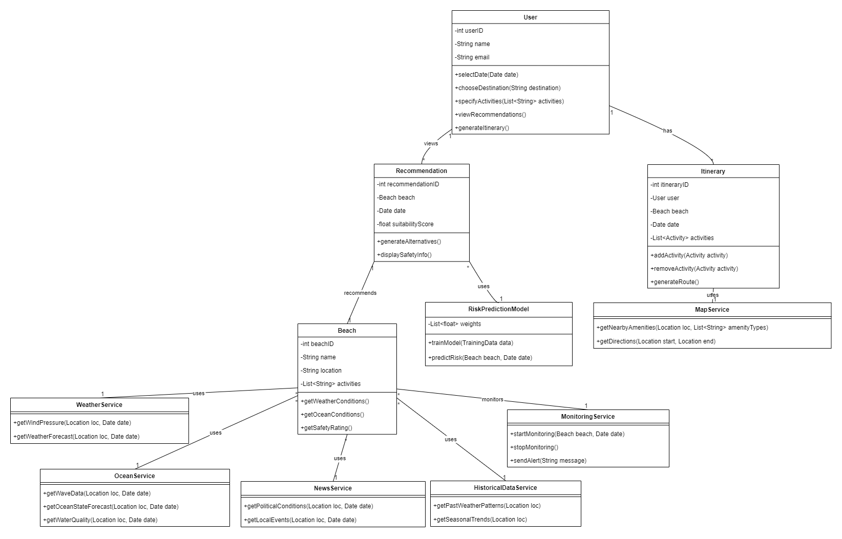
TECHNICAL APPROACH
AquaTeq
Class Diagram

Slide 6
FEASIBILITY AND VIABILITY
AquaTeq
Feasibility:
Data Availability - Using API for real time monitoring: INCOIS - accurate oceanographic data & OpenWeather API - provides trusted real-time weather data like wind speed etc.,
UI Consistency: Using React Native for cross-platform development ensures efficient development for both iOS and Android.
Cloud Processing (Azure/GCP): Scalable & Geolocation Services via Google Maps API
Viability:
.
Challenges
Solutions
Real time data accuracy & Managing large datasets
Internet issues in remote areas
Using API’s like INCOIS, IMD minimize accuracy risk and using cloud has high scalability.
SOS (For emergency) through No internet can negate connectivity issues in all areas
Market Need 2. Sustainability(Long-term) 3. User adoption

Slide 7
IMPACT AND BENEFITS
IDK
AquaTeq
The "B.R.E.E.Z.E" app is sure to have a significant impact on coastal tourists(Locals & Non locals) and authorities by enhancing safety and planning.
Socially
Real-time safety info
Reduces risk of accidents
Empowers tourists
Economically
Promotes safer experiences
Increases visitor numbers
Boosts local economies
Environmentally
Guides tourists to safer areas
Reduce human impact on ecosystems
Contributes to sustainable tourism

Slide 8
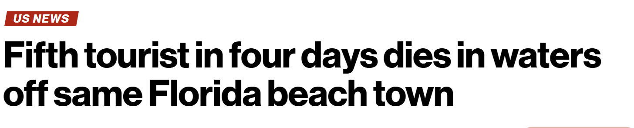
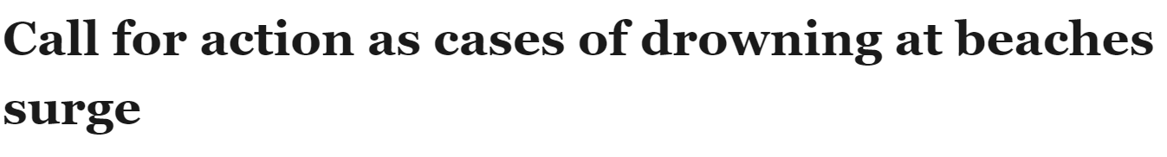
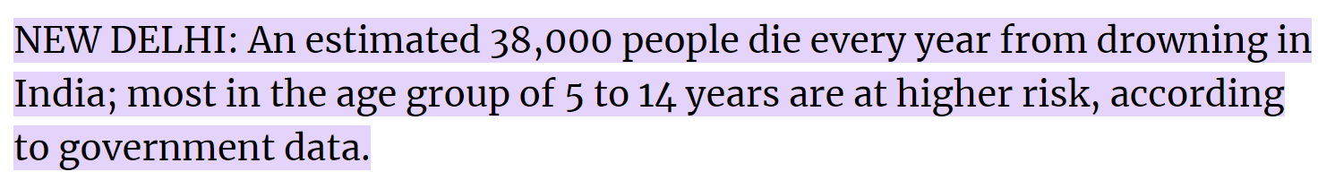
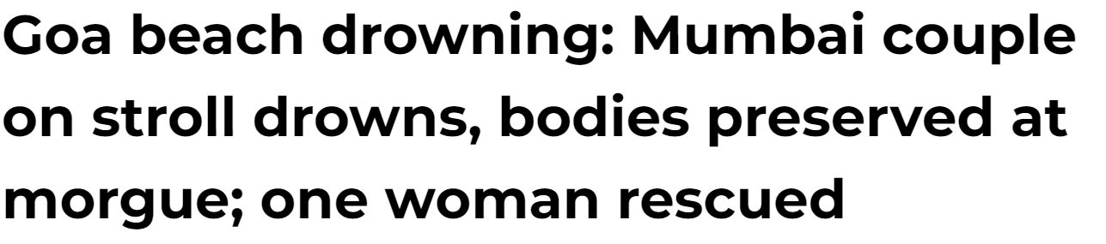
RESEARCH AND REFERENCES
AquaTeq
Survey
Many such cases occur due to either lack of safety precautions or unexpected tides.
Drowning is the third leading cause of unintentional injury death worldwide, accounting for 9% of all injury-related deaths.
There are over 300 000 annual drowning deaths worldwide.
New York Post
Times of India
Indian Express
Financial Express

Slide 9
RESEARCH AND REFERENCES
AquaTeq
INCOIS Official Website: https://incois.gov.in/
Beach API’s: https://api.howsthebeach.org/api/v1/docs and oceanic alerts from some REST API’s/
Meteorological Data Sources: For weather-related data, references include the India Meteorological Department (IMD) - https://mausam.imd.gov.in/

